Slide 1


IV Year B.Tech II Semester– Major Project Review (Review-3)
Time Series Analysis using ARIMA
Team Members Details
K. GIRISH 21N31A6729
Y. KARTHIK REDDY 21N31A6765
G. NIRMAL HRUDAY 21N31A6716
IV Year B.Tech – CSE Data Science
Under the Guidance of
Mr G Ranjith
ASSISTANT PROFESSOR
Department of Emerging Technologies

Slide 2
Outline
Abstract
Introduction
Existing System
Proposed System
Difference between Existing and Proposed
Literature Review
Architectural Diagram
Technical Requirement Specification
Other System Diagrams
Test Cases
Output Screens
References & Future Scope

Slide 3
Abstract
Time Series analysis is very important technique in finding the future trends in the different industrial business.
Time Series analysis has a wide range of techniques to find the future trends by the past data.
ARIMA(AutoRegressive Integrated Moving Average) is a core statistical method to find the future trends in the data.
We use the previous data and present data to find the hidden patterns and future trends to improve your performance of the industry.
Empower organizations to mitigate risks, reduce uncertainties, and achieve operational efficiency.
Implementing ARIMA with the ML model will improve the efficiency and can predict the trends with at most accuracy.

Slide 4
Introduction
Time series data records values over consistent time intervals, widely used in industries like finance, business, and weather forecasting.
Accurate forecasting is crucial for decision-making, resource planning, and gaining a competitive edge.
The ARIMA model is chosen for its ability to capture linear patterns, trends, and seasonality in time series data.
This project integrates ARIMA with data science workflows and ML for enhanced forecasting accuracy and scalability.
Applications include sales forecasting, stock price prediction, demand estimation, and resource optimization.
The project automates analysis and prediction, overcoming the limitations of manual methods.

Slide 5
Existing System
The Existing Systems are mainly focused on finding the trends using the machine learning techniques.
The existing systems are working with building the models in GRU and LSTM.
The existing performance metrics is purely calculated on the accuracy, confusion matrix and precision etc.
Both models address the vanishing gradient problem, which occurs in traditional RNNs, allowing for better training of deep networks.

Slide 6
Proposed System
The proposed system leverages ARIMA (AutoRegressive Integrated Moving Average) for time series forecasting.
It is designed to overcome the limitations of deep learning models like GRU and LSTM, which require extensive resources and large datasets.
ARIMA is computationally efficient and well-suited for datasets with linear trends and seasonality.
The system is scalable and can be integrated with real-time data for dynamic forecasting.
It targets industries like finance, business, and logistics, focusing on trend prediction, sales forecasting, and demand estimation.

Slide 7
Existing <vs> Proposed System
The existing system uses GRU and LSTM, which are deep learning models for handling complex, non-linear time series data.
The proposed system uses ARIMA, a statistical model designed for linear trends and seasonal patterns along with ML model.
GRU and LSTM alone are computationally intensive and take longer to train, whereas ARIMA is simpler and faster to train.
The existing system provides less interpretable results due to the black-box nature of deep learning models. In contrast, ARIMA offers clear insights into trends and seasonality.
The proposed system focuses on efficiency, simplicity, and interpretability, providing a resource-friendly alternative to deep learning models.

Slide 8
Literature Review
S.NO | Paper Title, Authors & Publication Details | Algorithm/ Technique Used | Advantages | Limitations
1. | Time Series Business Analysis, Philip B. Weerakody, Kok Wai Wong, Guanjin Wang, Wendell Ela, 2021. | Gated recurrent unit | Gated RNNs handle complex temporal dependencies. | Focus on imputation may limit better models.
2. | Time Series analysis Supermarket data analysis, José F. Torres, Dalil Hadjout, Abderrazak Sebaa, Francisco Martínez-Álvarez, 2020 | LSTM(Long Short Term Memory) | Captures complex patterns, handles big data, improves accuracy.. | Needs large data, high computation, and fine-tuning.

Slide 9
Architecture Diagram or
System Diagram

Slide 10
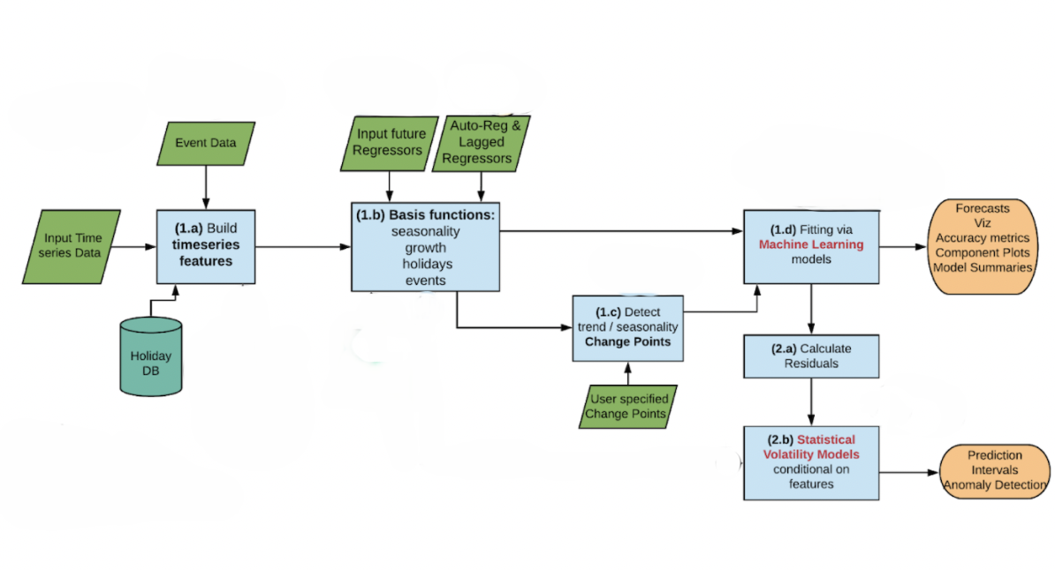
System Architecture
ARIMA Model
Predicted Trends with out ARIMA
Forecasting Trends with ARIMA

Slide 11
Technical Requirements Specifications

Slide 12
Software Requirement Specifications (SRS)
Operating System : Windows 11 or Mac OS or Linux
Programming language : Python 3.8.0
IDLE or Software: Visual Studio Code
Dataset Application : Microsoft Excel

Slide 13
Hardware Requirement Specifications
RAM : 8GB (Recommended)
Storage space : Memory 512GB
Processor : intel i5 or Ryzen5

Slide 14
Application Modules
Following are the application modules
Module -1 : User Module
Module -2: Admin Module
Module -3: Back-End Module

Slide 15
UML Diagrams & Other System Diagrams

Slide 16
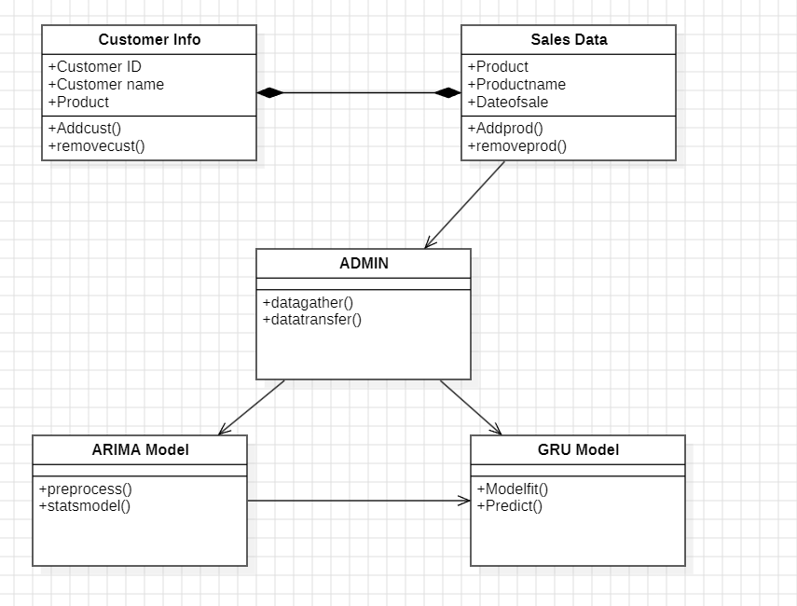
Class Diagram

Slide 17
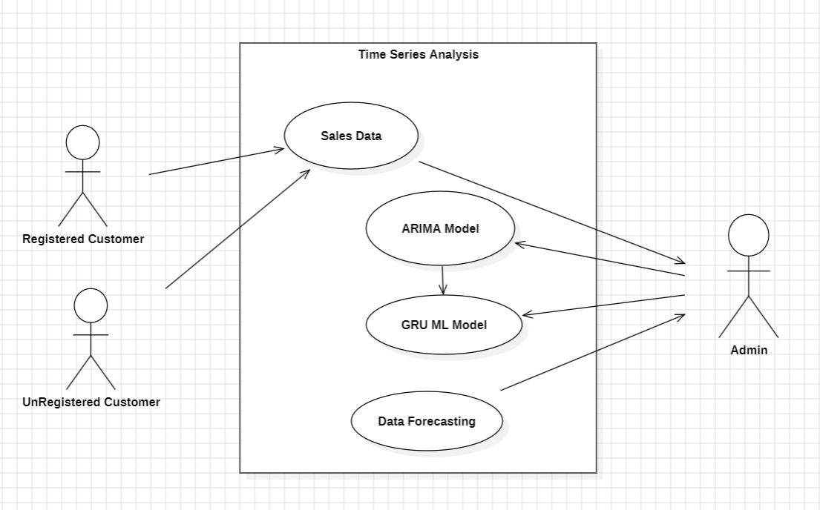
Use-Case Diagram

Slide 18
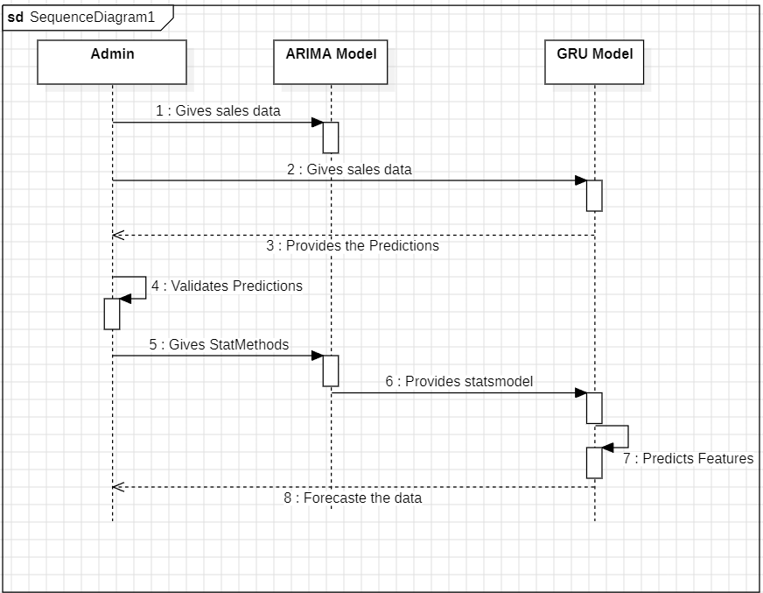
Sequence Diagram

Slide 19
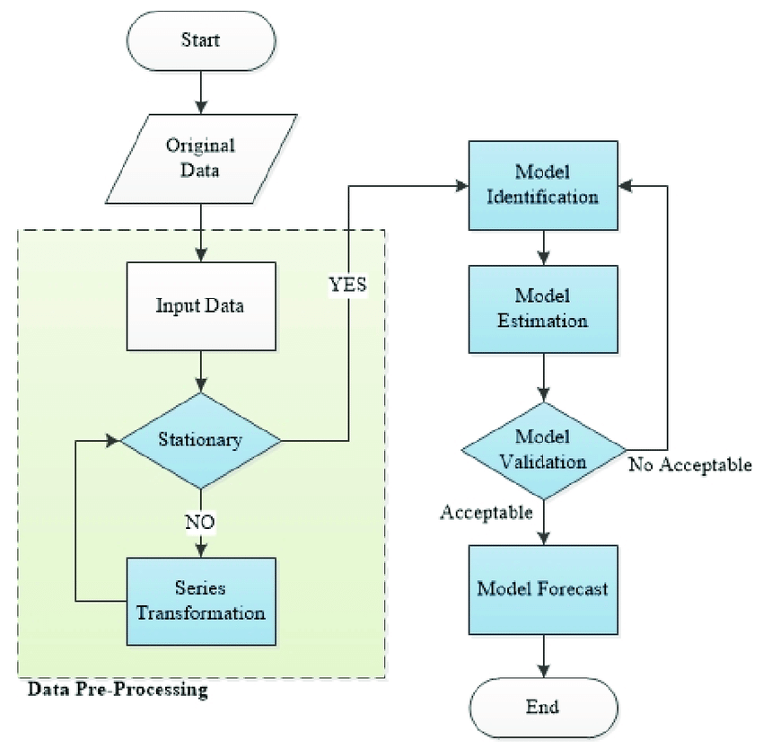
Activity Diagram

Slide 20
About your Application
Our project integrates ARIMA (AutoRegressive Integrated Moving Average) with GRU (Gated Recurrent Unit) to improve time series forecasting accuracy.
ARIMA is a statistical model that captures linear trends and works well with stationary data after differencing.
GRU is a deep learning model designed to learn sequential dependencies and capture non-linear patterns in time series data.
The hybrid approach combines ARIMA’s strength in modeling linear trends with GRU’s ability to learn complex relationships, improving overall prediction accuracy.
Applications include financial market predictions, stock price forecasting, demand forecasting, weather analysis, and industrial or healthcare data trends.

Slide 21
Testing and Test Cases
Test Case No
Description
Result
Test Case No | Description | Result
TC1.1 | Verify correct fitting of ARIMA model with selected parameters. | ARIMA model is fitted successfully with optimal (p, d, q) values.
TC1.2 | Ensure GRU model correctly learns residuals from ARIMA predictions. | GRU model trains successfully with decreasing loss over epochs.
TC2.1 | Verify hybrid forecast by combining ARIMA and GRU outputs. | Final prediction is accurately generated as ARIMA + GRU outputs.
TC2.2 | Evaluate prediction accuracy using RMSE and MAE metrics. | RMSE and MAE values are within acceptable thresholds.
TC3.1 | Ensure handling of missing data in the time series without pipeline errors. | Missing values are handled appropriately using interpolation methods.

Slide 22
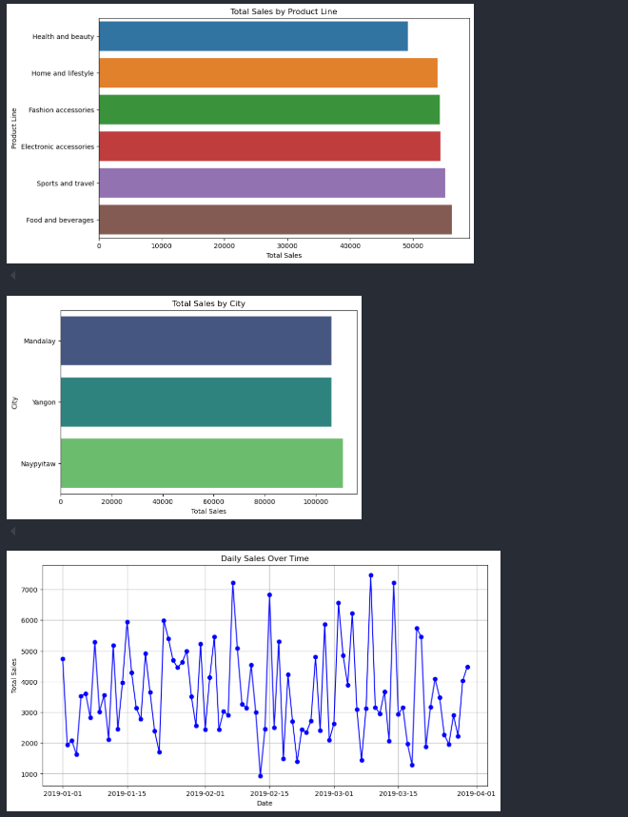
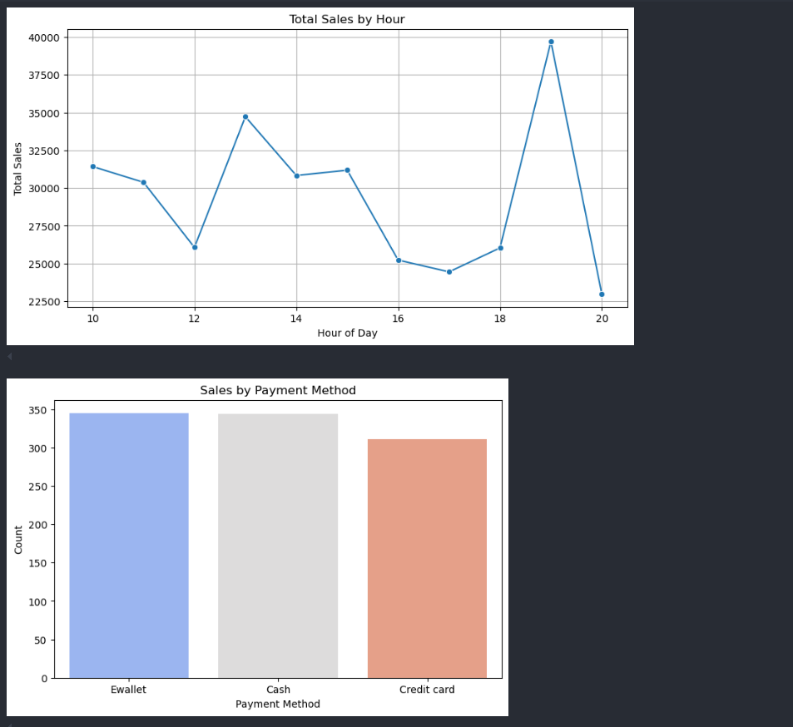
Output Screens / Screenshots
Analyzing the Time Series Data

Slide 23
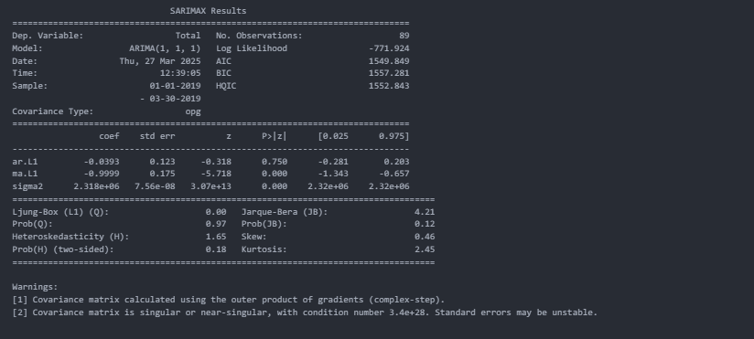
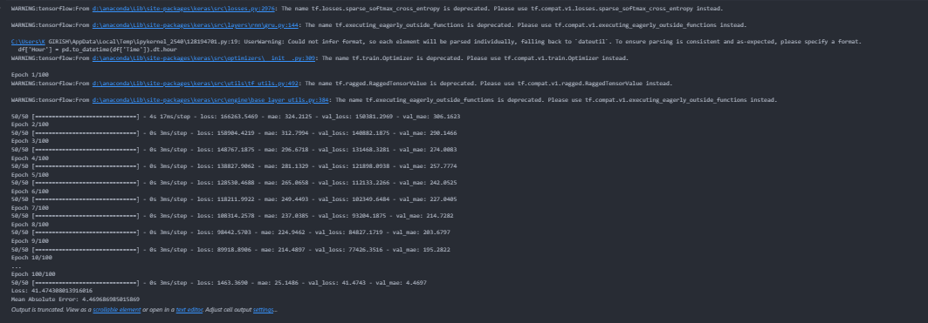
Output Screens / Screenshots
Training the GRU According to the requirments
ARIMA model outputs

Slide 24
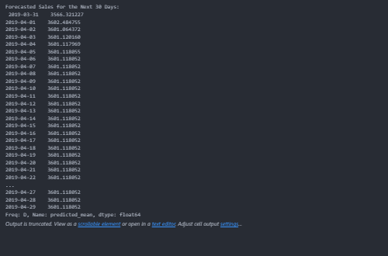
Output Screens / Screenshots
Forecasting the Predicted Sales

Slide 25
Reference and Future Scope
"Comparison of ARIMA and GRU Models for High-Frequency Time Series Forecasting"
https://journal.unnes.ac.id/nju/sji/article/view/45965
"Modeling Opening Price Spread of Shanghai Composite Index Based on ARIMA-GRU/LSTM Hybrid Model"
https://journals.plos.org/plosone/article?id=10.1371/journal.pone.0299164
"A Combined Model of ARIMA-GRU to Forecast Stock Price"
https://link.springer.com/chapter/10.1007/978-981-15-7533-4_80
"The Use of ARIMA, LSTM and GRU Models in Time Series Hybridization with Practical Application"
https://ijnaa.semnan.ac.ir/article_7110.html
"A Comparative Analysis of Forecasting Financial Time Series Using ARIMA, LSTM, and BiLSTM"
https://arxiv.org/abs/1911.09512
"Time Series Forecasting Based on Deep Learning CNN-LSTM-GRU Model on Stock Prices"
https://ijettjournal.org/Volume-71/Issue-6/IJETT-V71I6P215.pdf​
"A Novel Hybrid Time Series Deep Learning Model for Forecasting of Cotton Yield in India"
https://link.springer.com/article/10.1007/s41870-024-02327-
"Comparative Analysis of Gated Recurrent Units (GRU), Long Short-Term Memory (LSTM), and ARIMA Models for Forecasting COVID-19 Cases"
https://www.sciencedirect.com/science/article/pii/S1110016822000138

Slide 26
Reference and Future Scope
The model can be extended for real-time data forecasting.
It can be improved to handle multivariate time series.
A dashboard or API can be developed for user interaction.
Hybrid models like ARIMA-LSTM can boost accuracy.
The model can be used for detecting anomalies.
It can be scaled using big data platforms like Spark.
AutoML can be added for automatic parameter tuning.
The approach can be applied in various domains like finance and healthcare.

Slide 27
Thank you
K. GIRISH 21N31A6729
Y. KARTHIK REDDY 21N31A6765
G. NIRMAL HRUDAY 21N31A6716

